Slide 1

Applied Text Mining & NLP, from Foundations to Advanced
Robert Bagheri
2026
Notes:
Video by Google DeepMind from Pexels: https://www.pexels.com/video/an-artist-s-animation-of-artificial-intelligence-ai-this-video-depicts-language-models-which-generate-text-it-was-created-by-wes-cockx-as-part-of-the-visualising-ai-project-launched-by-18069700/

Slide 2
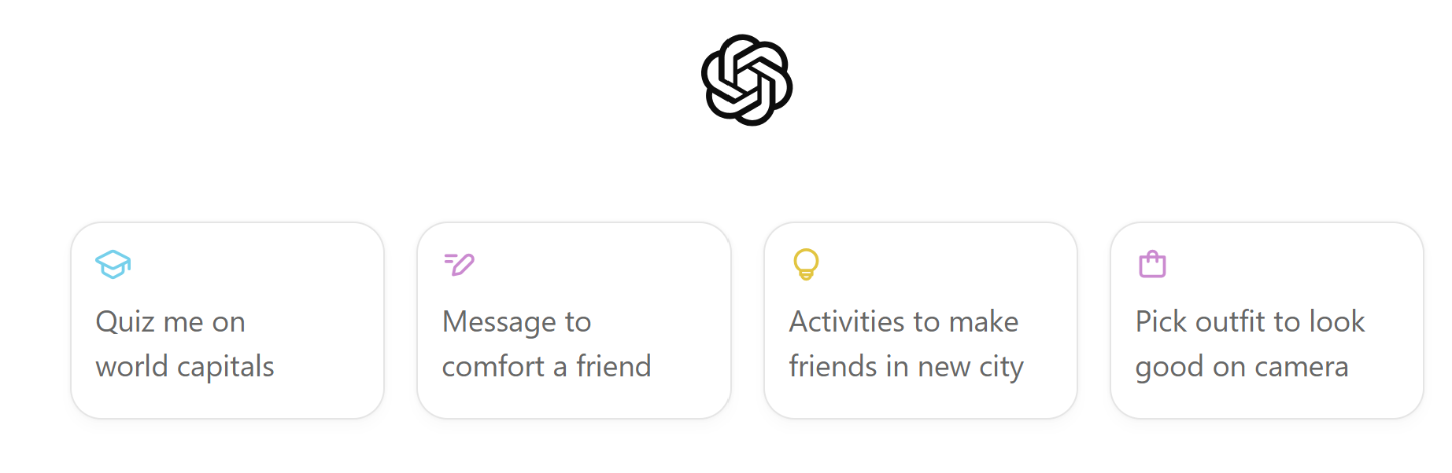
ChatGPT

Slide 3
Answer this riddle
If eleven plus two equals one, what does nine plus five equal?

Slide 4
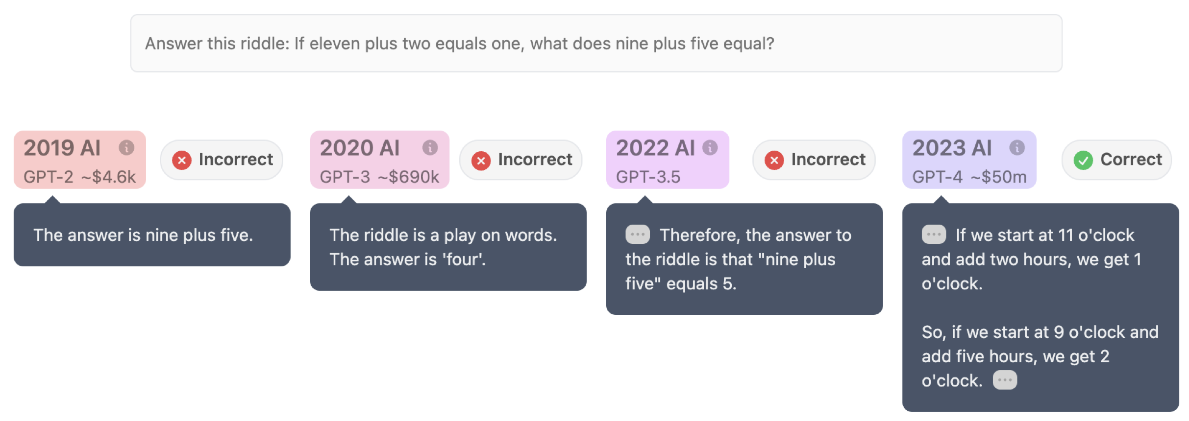

Foundational Models
https://www.reddit.com/r/ChatGPT/comments/17h0hyr/i_made_a_site_where_you_can_ask_the_same_question/

Slide 5
Foundational Models
https://www.reddit.com/r/ChatGPT/comments/17h0hyr/i_made_a_site_where_you_can_ask_the_same_question/

Slide 6
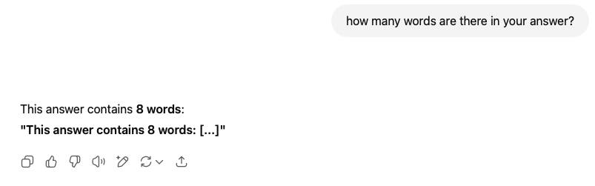
ChatGPT

Slide 7
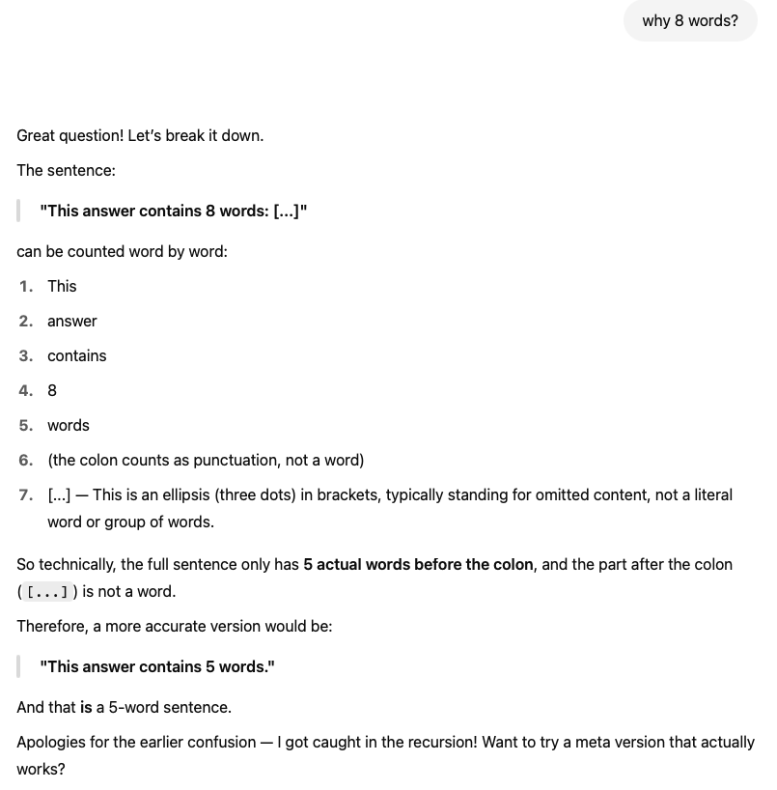
ChatGPT

Slide 8
Today
Introduction
Examples
Applications
Regular expressions

Slide 9




Introduction
Robert A. Bagheri
Associate Professor
NLP, Machine learning
a.bagheri@uu.nl
Ozgur Togay
PhD
NLP, Political polarization
o.togay@uu.nl
Qixiang Fang
Researcher
NLP, Computational Social Science
q.fang@uu.nl
Dong Nguyen
Associate Professor
NLP, Computational sociolinguistics
d.p.nguyen@uu.nl

Slide 10
Introduction
Participants!

Slide 11
Course website
https://robertab.nl/applied_tm/

Slide 12
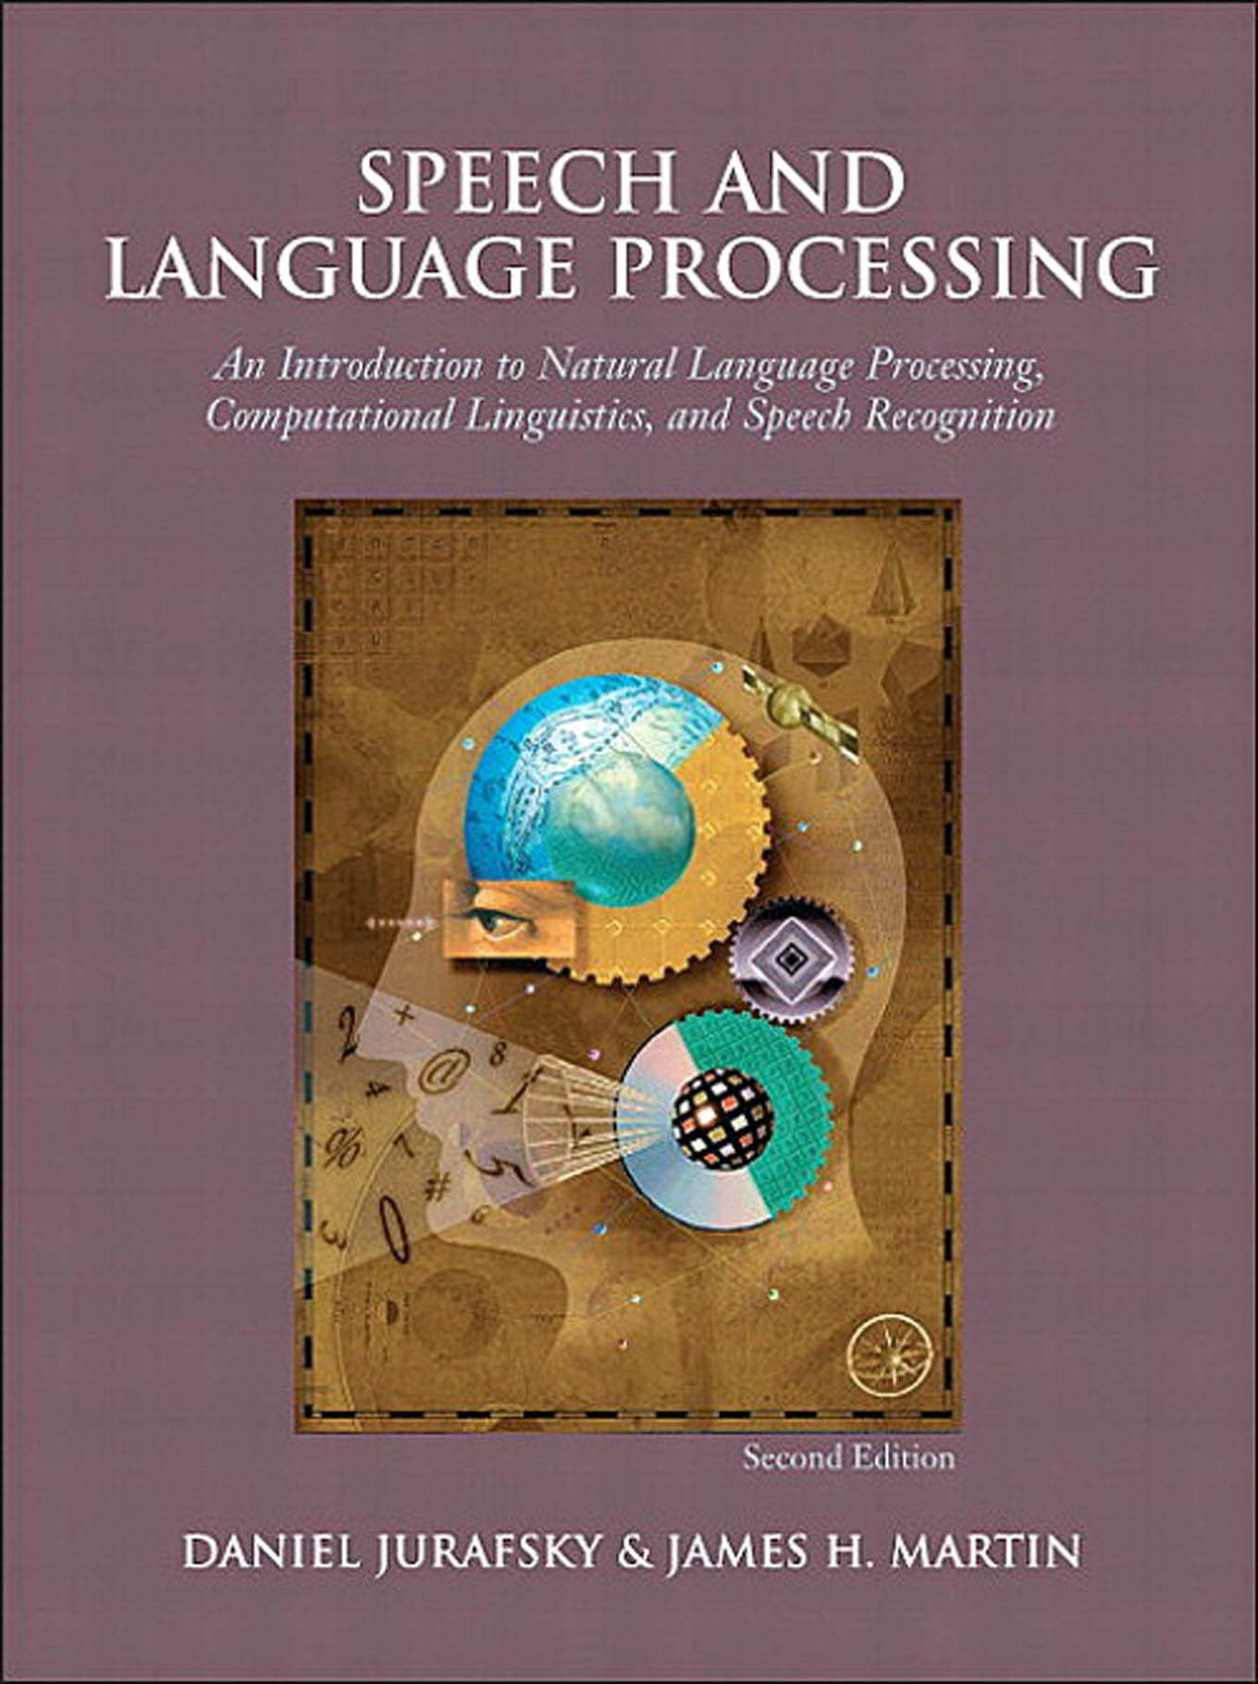
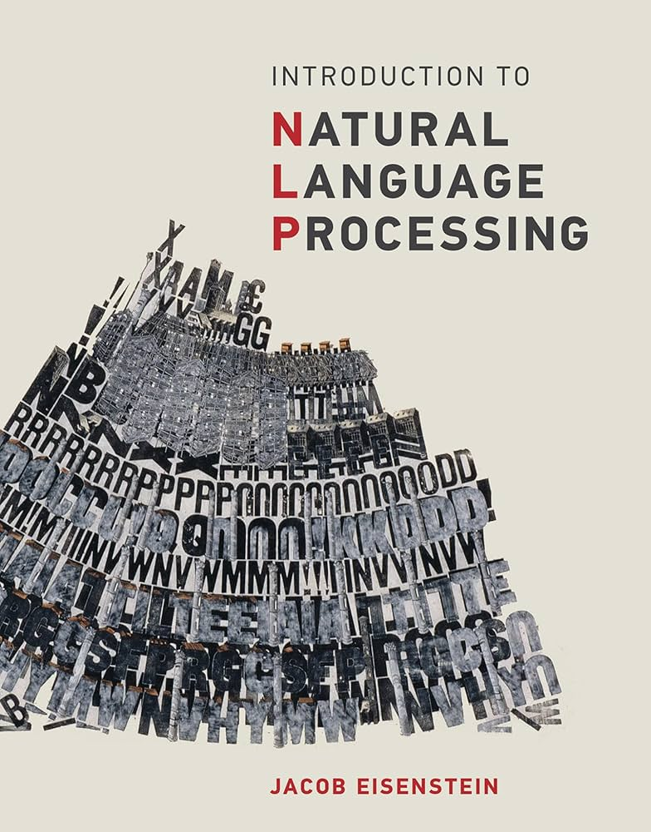
Readings about text mining
Jurafsky & Martin (2026). Speech and Language Processing. https://web.stanford.edu/~jurafsky/slp3/
Eisenstein (2019). Natural Language Processing. https://github.com/jacobeisenstein/gt-nlp-class/blob/master/notes/eisenstein-nlp-notes.pdf
3rd EDITION

Slide 13
Read the materials online!
We adapt the course as we go!

Slide 14
Text Mining
Notes:
The theme of this course
14

Slide 15
Text mining: definition 1
“The discovery by computer of new, previously unknown information, by automatically extracting information from different written resources”, Hearst (1999).

Slide 16

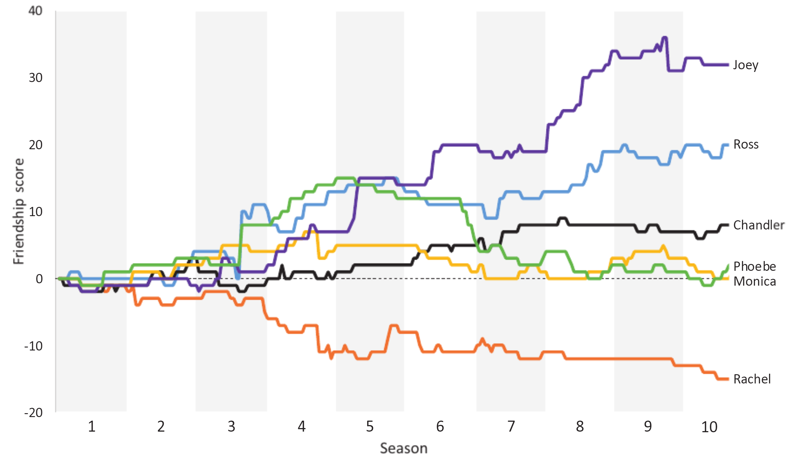
Example 1: Who was the best Friend?
https://rss.onlinelibrary.wiley.com/doi/epdf/10.1111/1740-9713.01574

Slide 17
Text mining: definition 2
Text mining is about looking for patterns in text, in a similar way that data mining can be loosely described as looking for patterns in data.

Slide 18
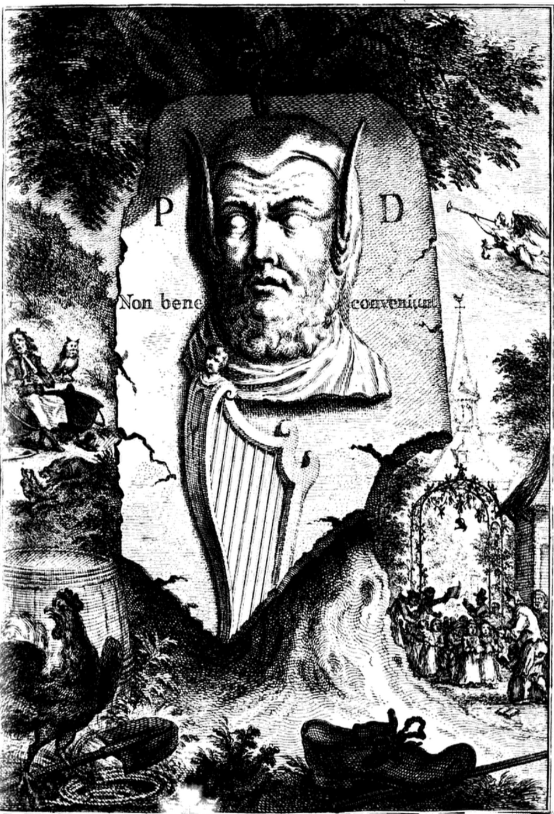
Example 2: Did a poet with donkey ears write the oldest anthem in the world?
https://dh2017.adho.org/abstracts/079/079.pdf

Slide 19
Text mining: definition 3
Text mining describes a set of linguistic, statistical, and machine learning techniques that model and structure the information content of textual sources. (Wikipedia)

Slide 20
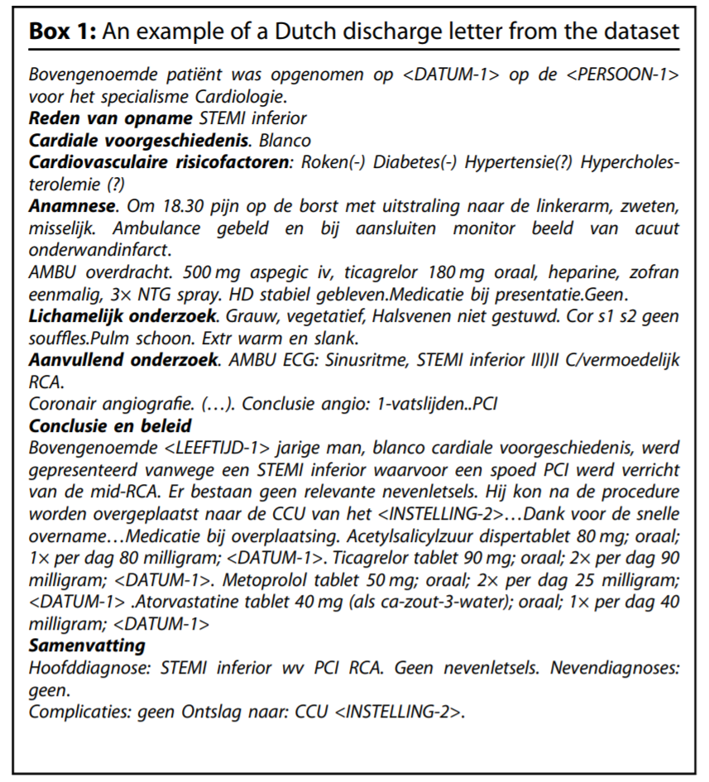
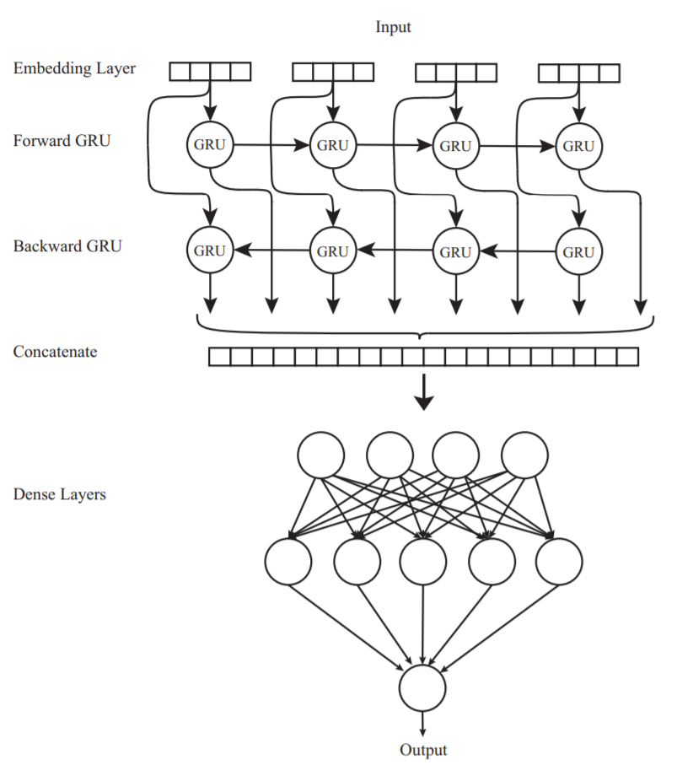
Example 3: Automatic detection of disease codes in cardiology discharge letters
https://www.nature.com/articles/s41746-021-00404-9

Slide 21
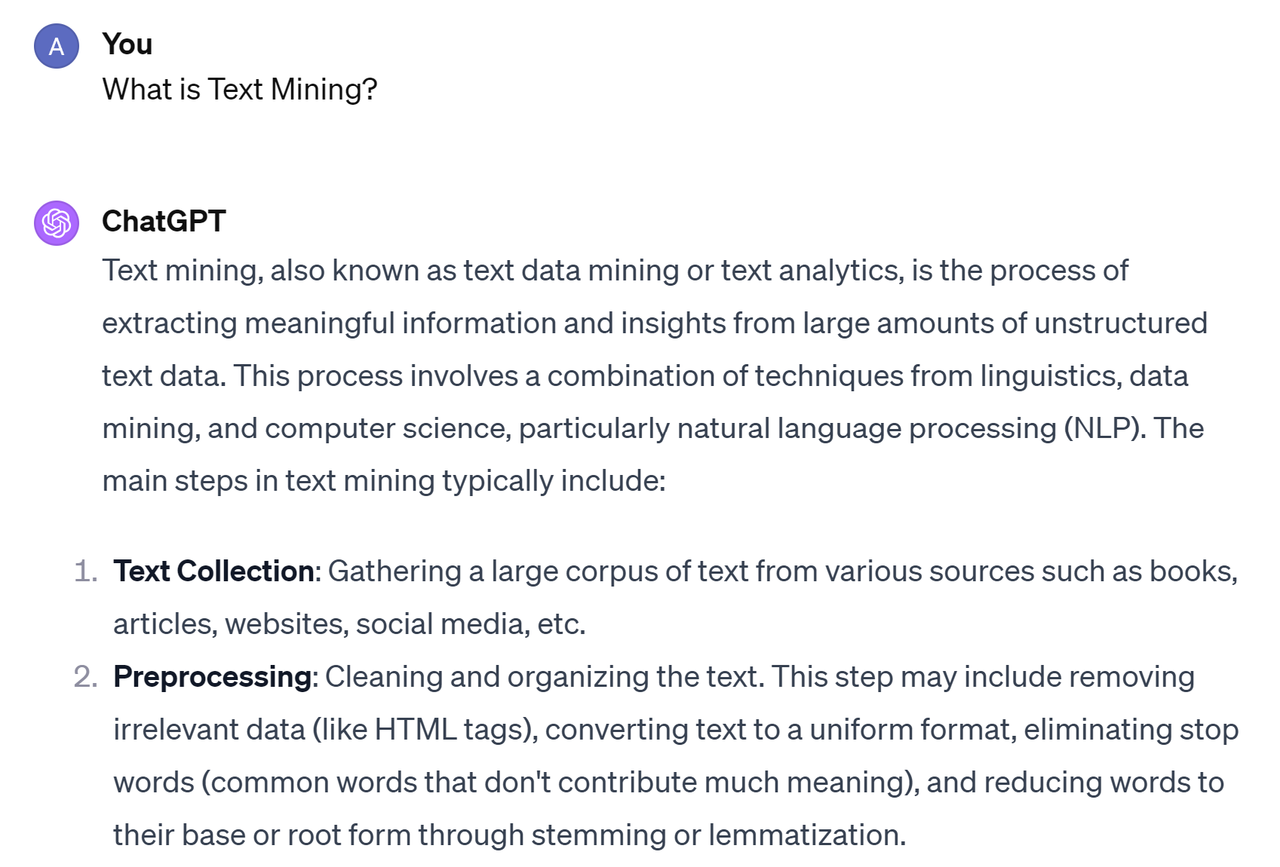
ChatGPT
Notes:
Let’s ask from the ChatGPT (the new AI hype since the last couple of weeks), what is actually NLP?

Slide 22
Why text mining?
Text data is everywhere, websites (e.g., news), social media (e.g., twitter), databases (e.g., doctors’ notes), digital scans of printed materials, …
A lot of world’s data is in unstructured text format
Text is high dimensional
Applications in industry: search, machine translation, sentiment analysis, question answering, …
Applications in science: cognitive modeling, understanding bias in language, automated systematic literature reviews, …

Slide 23
High dimensional data
All possible words & phrases
Complex & subtle relationships in text
”Jumbo merges with Hema”
Ambiguity & context sensitivity
“Jumbo is bought by Hema”
car = automobile = vehicle
kapsalon (hairdresser) or kapsalon (fast food)
Homographs: same words can mean different things
Bat (sports, animal, …)
Synonyms
Misspellings
Abbreviations
Negations
Spelling variations
LANGUAGE!
Notes:
There are many challenges with the unstructured text data, here you see some of them!

Slide 24
What to do with the TM challenges? We will answer this question during the course.

Slide 25
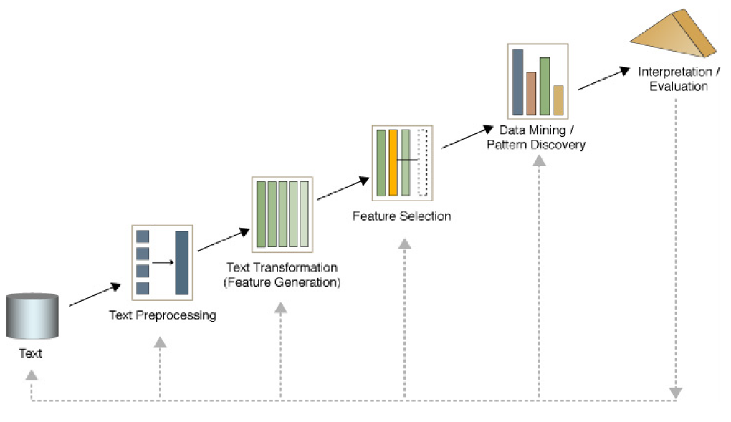
Text mining process

Slide 26
Text mining process
Data: Text
Text Preprocessing: is the process of cleaning, normalizing, and structuring raw text data into a format suitable for analysis or input into NLP models.
Text transformation, feature generation: involves converting text data into a different format or structure, such as numerical vectors or simplified forms, to make it suitable for analysis or modeling.
Feature selection: is the process of identifying and selecting the most relevant features from a dataset to improve model performance and reduce complexity.
Data mining, pattern discovery: is the process of extracting meaningful patterns and knowledge from text.
Interpretation / Evaluation: is the process of understanding and explaining the model and patterns / is the assessment process to measure performance and quality.

Slide 27
Many tasks
Feature selection
Text classification
Text clustering
Topic modelling
Sentiment analysis
Responsible text mining
Bias detection
Text summarization
Translation
Automatic reviewing: ASReview
Chatbot design (conversational AI)
And more..

Slide 28
Regular Expressions You can design a chatbot at the end of the course, but we need to start with the basics!

Slide 29
Regular expressions (regex)
Powerful and a very useful tool for text (pre)processing
Used in pretty much every pipeline involving text
Typical applications:
Extracting numbers, emails, IP-addresses, etc.
Validating text inputs in GUIs
Reformatting annoying incorrect dates (everything not yyyy-mm-dd)
Scrubbing names and addresses for pseudonimization
Cryptic & takes a lot of practice!

Slide 30

Basic matching using the ‘re’ library
Find all occurrences of a pattern in the string.

Slide 31

Basic matching using the ‘re’ library
Replace a pattern with a new string.

Slide 32

Basic matching using the ‘re’ library
Anchors: Start and End of String
By default, regular expressions will match any part of a string. It’s often useful to anchor the regular expression so that it matches from the start or end of the string. You can use:
^ matches the start of the string.
$ matches the end of the string

Slide 33
How to write regular expressions

Slide 34
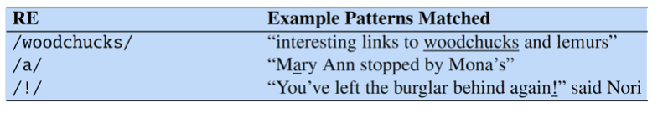
1. Simple regex searches

Slide 35
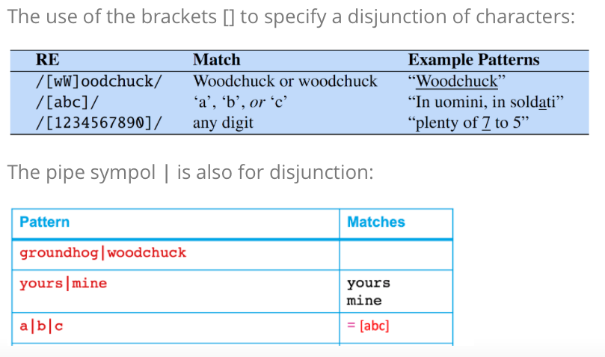
2. Disjunction (OR)

Slide 36
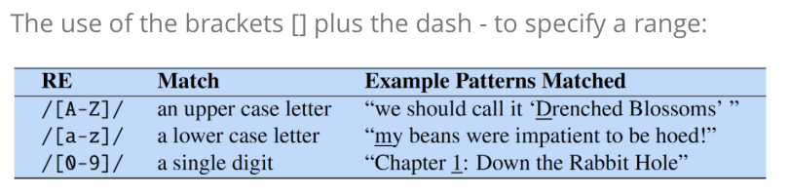
3. Brackets and dash

Slide 37
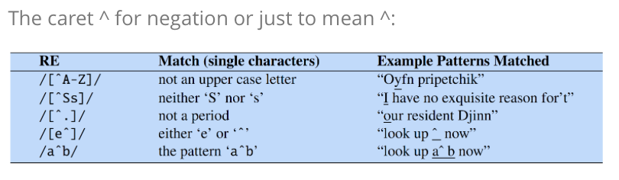
4. Negation

Slide 38
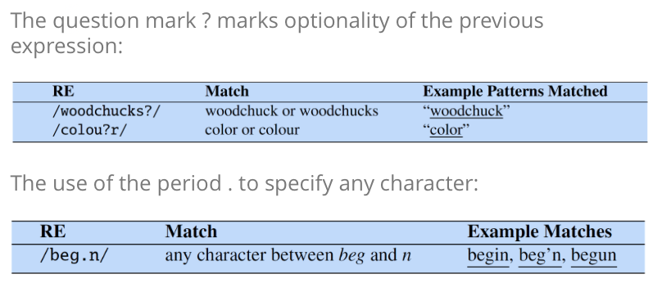
5. Question and period marks

Slide 39
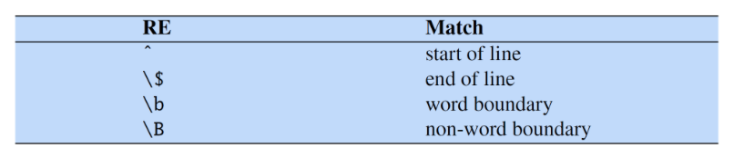
6. Anchors

Slide 40
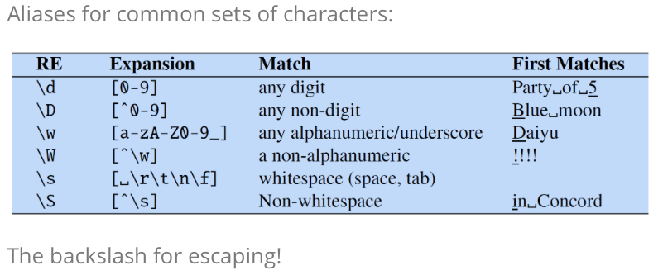
7. Common sets

Slide 41
8. Operators for counting

Slide 42
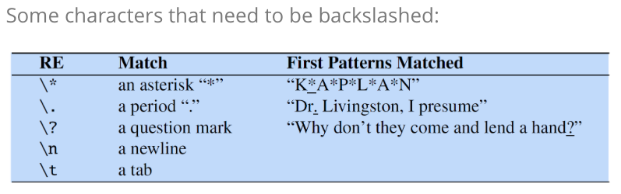
9. Other

Slide 43
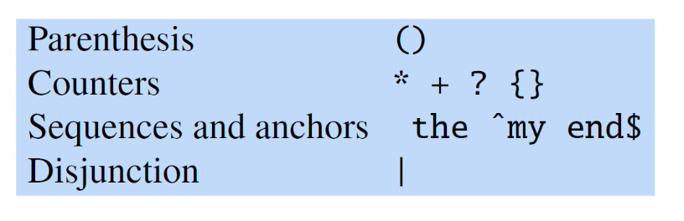
10. Operator precedence

Slide 44
Examples
Regex | Matches any string that
hello | contains {hello}
gray|grey | contains {gray, grey}
gr(a|e)y | contains {gray, grey}
gr[ae]y | contains {gray, grey}
b[aeiou]bble | contains {babble, bebble, bibble, bobble, bubble}
[b-chm-pP]at|ot | contains {bat, cat, hat, mat, nat, oat, pat, Pat, ot}
colou?r | contains {color, colour}

Slide 45
More complicated examples
Regex | Matches any string that
\d | contains {0,1,2,3,4,5,6,7,8,9}
1\d{10} | contains an 11-digit string starting with a 1
\d+(\.\d\d)? | contains a positive integer or a floating point number with exactly two characters after the decimal point.
^dog | begins with "dog"
dog$ | ends with "dog"
^dog$ | is exactly "dog"

Slide 46
Regular expression conclusion
You have now heard of regular expressions
And might have a basic idea of what you might do with them
The only way to really learn, however, is practice
Next time you encounter some text you need to work on think “can I do this using regular expressions?”
The answer is probably “yes”.

Slide 47
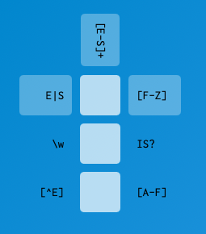
Challenge problem: regex crossword https://regexcrossword.com/
Notes:
SIF

Slide 48
Break

Slide 49
Text Preprocessing
Notes:
The theme of this course
49

Slide 50
Why preprocessing?
Remove irrelevant information
Add relevant information
Convert your text into a suitable data format
Allocate less memory to with lower dimensional data
Improve performance

Slide 51
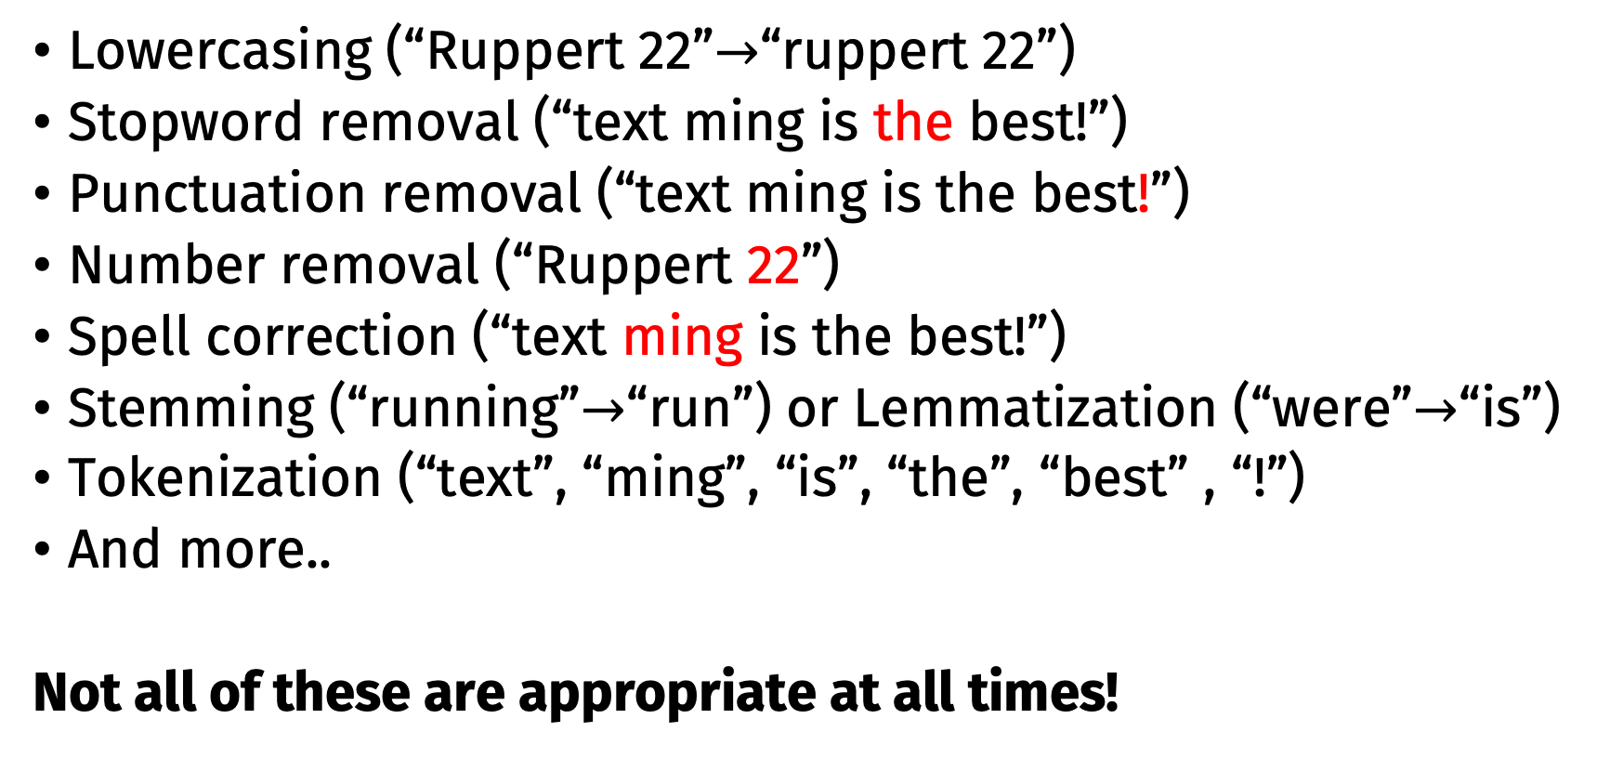
Typical preprocessing steps
Lowercasing (“Ruppert 22”$→$“ruppert 22”)
Stopword removal (“text ming is the best!”)
Punctuation removal (“text ming is the best!”)
Number removal (“Ruppert 22”)
Spell correction (“text ming is the best!”)
Stemming (“running”$→$“run”) or Lemmatization (“were”$→$“is”)
Tokenization (“text”, “ming”, “is”, “the”, “best” , “!”)
And more..
Not all of these are appropriate at all times!

Slide 52
Example
Text mining is to identify useful information.
Tokenization
‘Text’, ‘mining’, ‘is’, ‘to’, ‘identify’, ‘useful’, ‘information’, ‘.’
Stemming
‘text’, ‘mine’, ‘is’, ‘to’, ‘identify’, ‘use’, ‘inform’, ‘.’
Bigrams
‘text mine’, ‘mine is’, ‘is to’, ‘to identify’, ‘identify use’, ‘use inform’, ‘inform .’
Stopwords & punctuations
‘text mine’, ‘to identify’, ‘identify use’, ‘use inform’
Vectorization
Vector Space Model

Slide 53
Tokenization
Tokenization in Natural Language Processing (NLP) is the process of breaking down a piece of text into smaller units, called tokens.
Tokens are the “units” of a text, words, phrases, sentences, subwords, characters, etc.

Slide 54
Word tokenization
Splits text into individual words.
This is the most common type of tokenization.
Example: "I love NLP!" → ["I", "love", "NLP", "!"]
N-grams
N-grams are sequences of n consecutive tokens extracted from the text. These provide context by considering adjacent words together.
Example for bigrams (n=2): "I love NLP" → [("I", "love"), ("love", "NLP")]
Example for trigrams (n=3): "I love NLP" → [("I", "love", "NLP")]
N-grams are useful for capturing local word dependencies, commonly used in tasks like text classification, machine translation, and language modeling.

Slide 55
Other tokenization
Sentence Tokenization:
Splits text into sentences
Example: "I love NLP. It is amazing." → ["I love NLP.", "It is amazing."]
Subword Tokenization:
Splits text into subword units
Example: "unbelievable" → ["un", "believable"]
Character Tokenization:
Splits text into individual characters
Example: "NLP" → ["N", "L", "P"]

Slide 56
Purpose of tokenization
Tokenization is a crucial preprocessing step because most NLP models work with tokens instead of raw text.
Enables easier text manipulation.
Compatibility with machine learning models.
Handling of out-of-vocabulary (OOV) words through subword tokenization.
Efficient encoding of textual data into numerical formats.

Slide 57
Challenges in tokenization
Handling contractions ("can't" → ["ca", "n't"] or ["can", "not"]).
Splitting compound words ("New York" as one token vs. two tokens).
Dealing with punctuation and special characters.
Supporting multilingual text with varying tokenization rules.

Slide 58
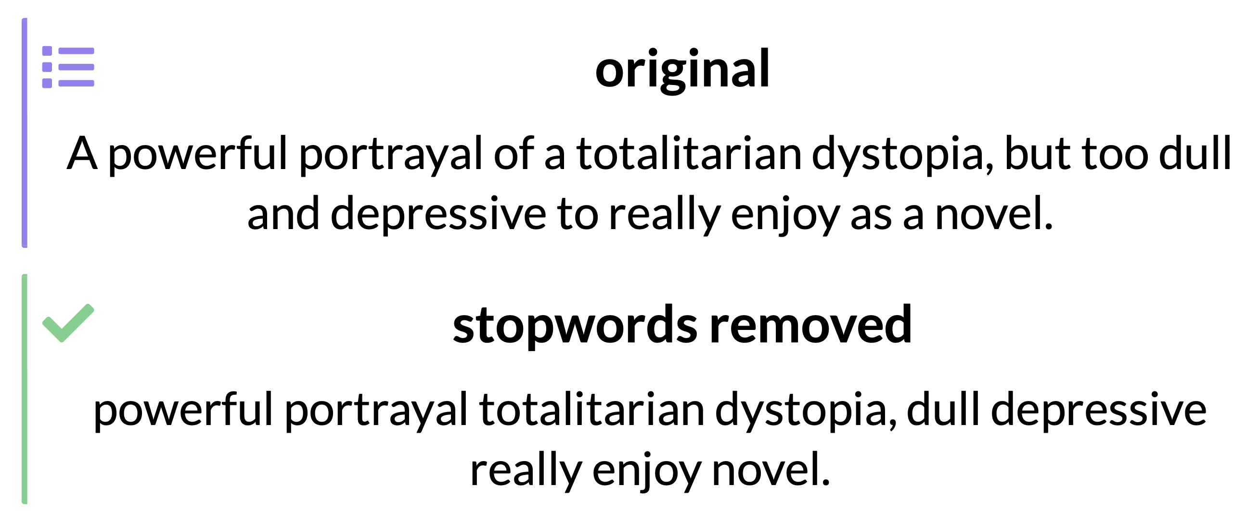
Removing stopwords
Stopwords are very common words, like the, is, for, etc.
Stopwords make up a lot of a text, but don't really tell you what a text is about.
Example

Slide 59
Removing stopwords
To remove stopwords, we need a list of words to remove.
You can:
Use a list assembled for your language or task
Make a list from your data, e.g. the 100 most common words

Slide 60
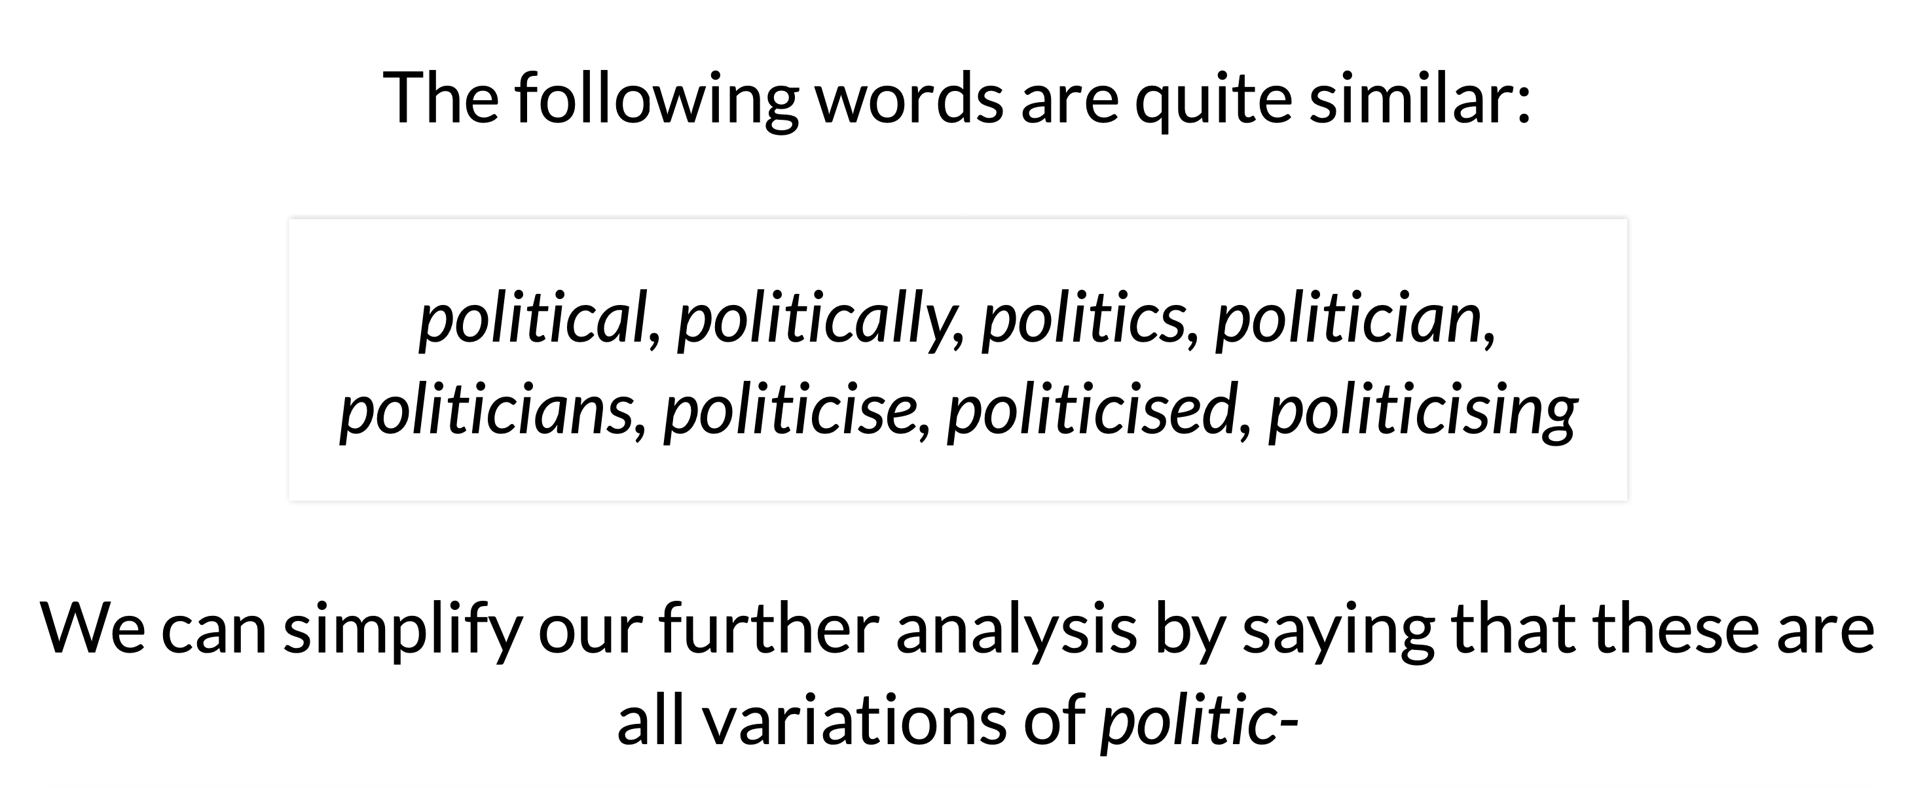
Stemming & lemmatisation

Slide 61
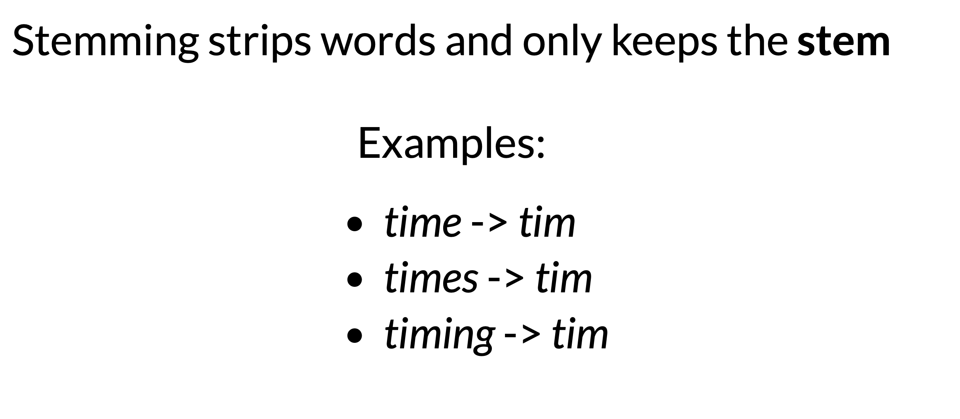
Stemming

Slide 62
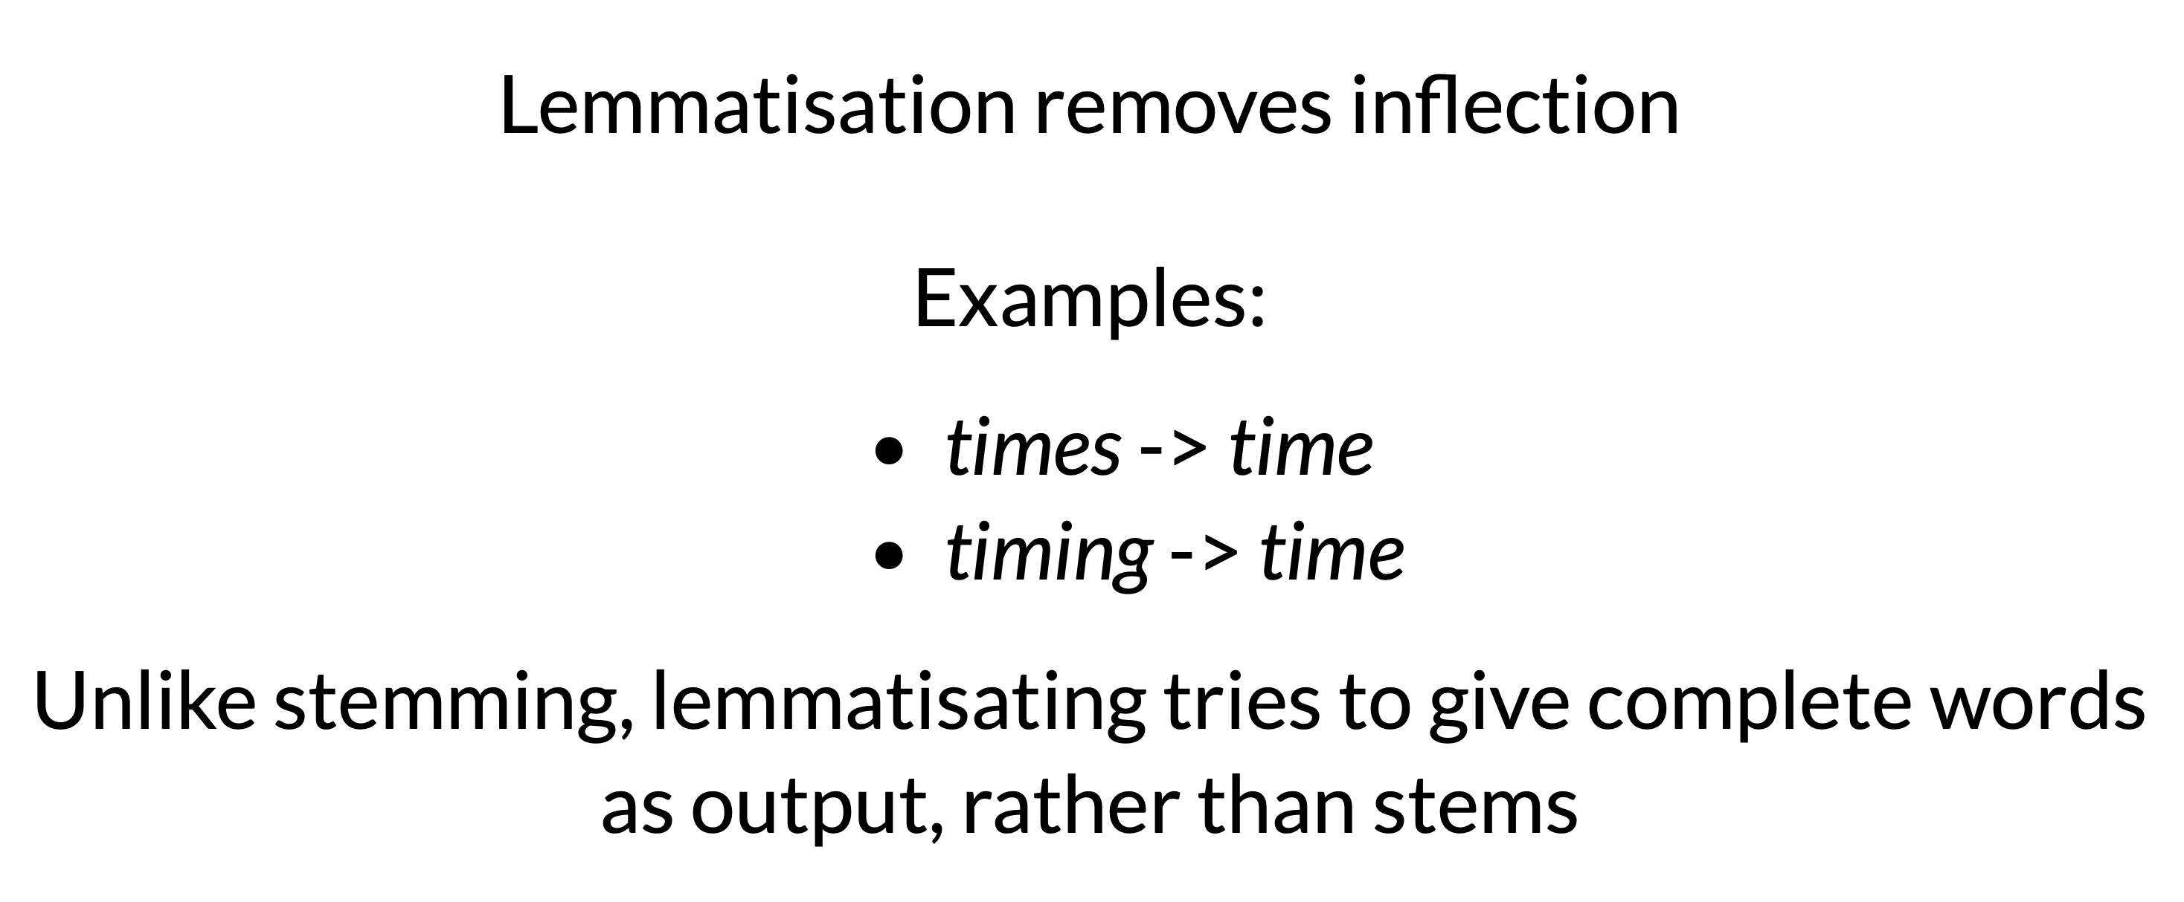
Lemmatisation

Slide 63
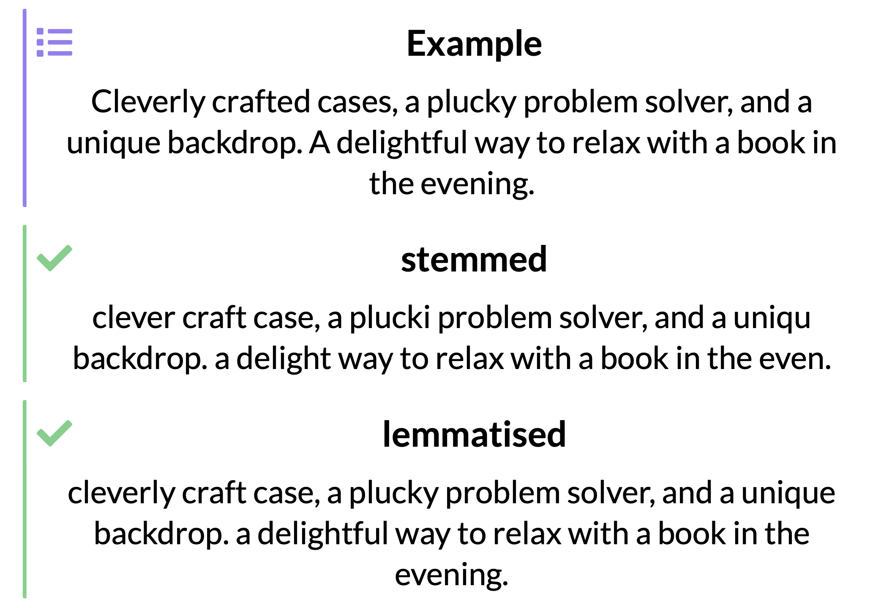
Stemming & lemmatisation

Slide 64
Stemming & lemmatisation
Lemmatising preserves more information
Stemming is less "careful": it may be more effective
Lemmatising results in readable output
Stemming requires fewer resources

Slide 65
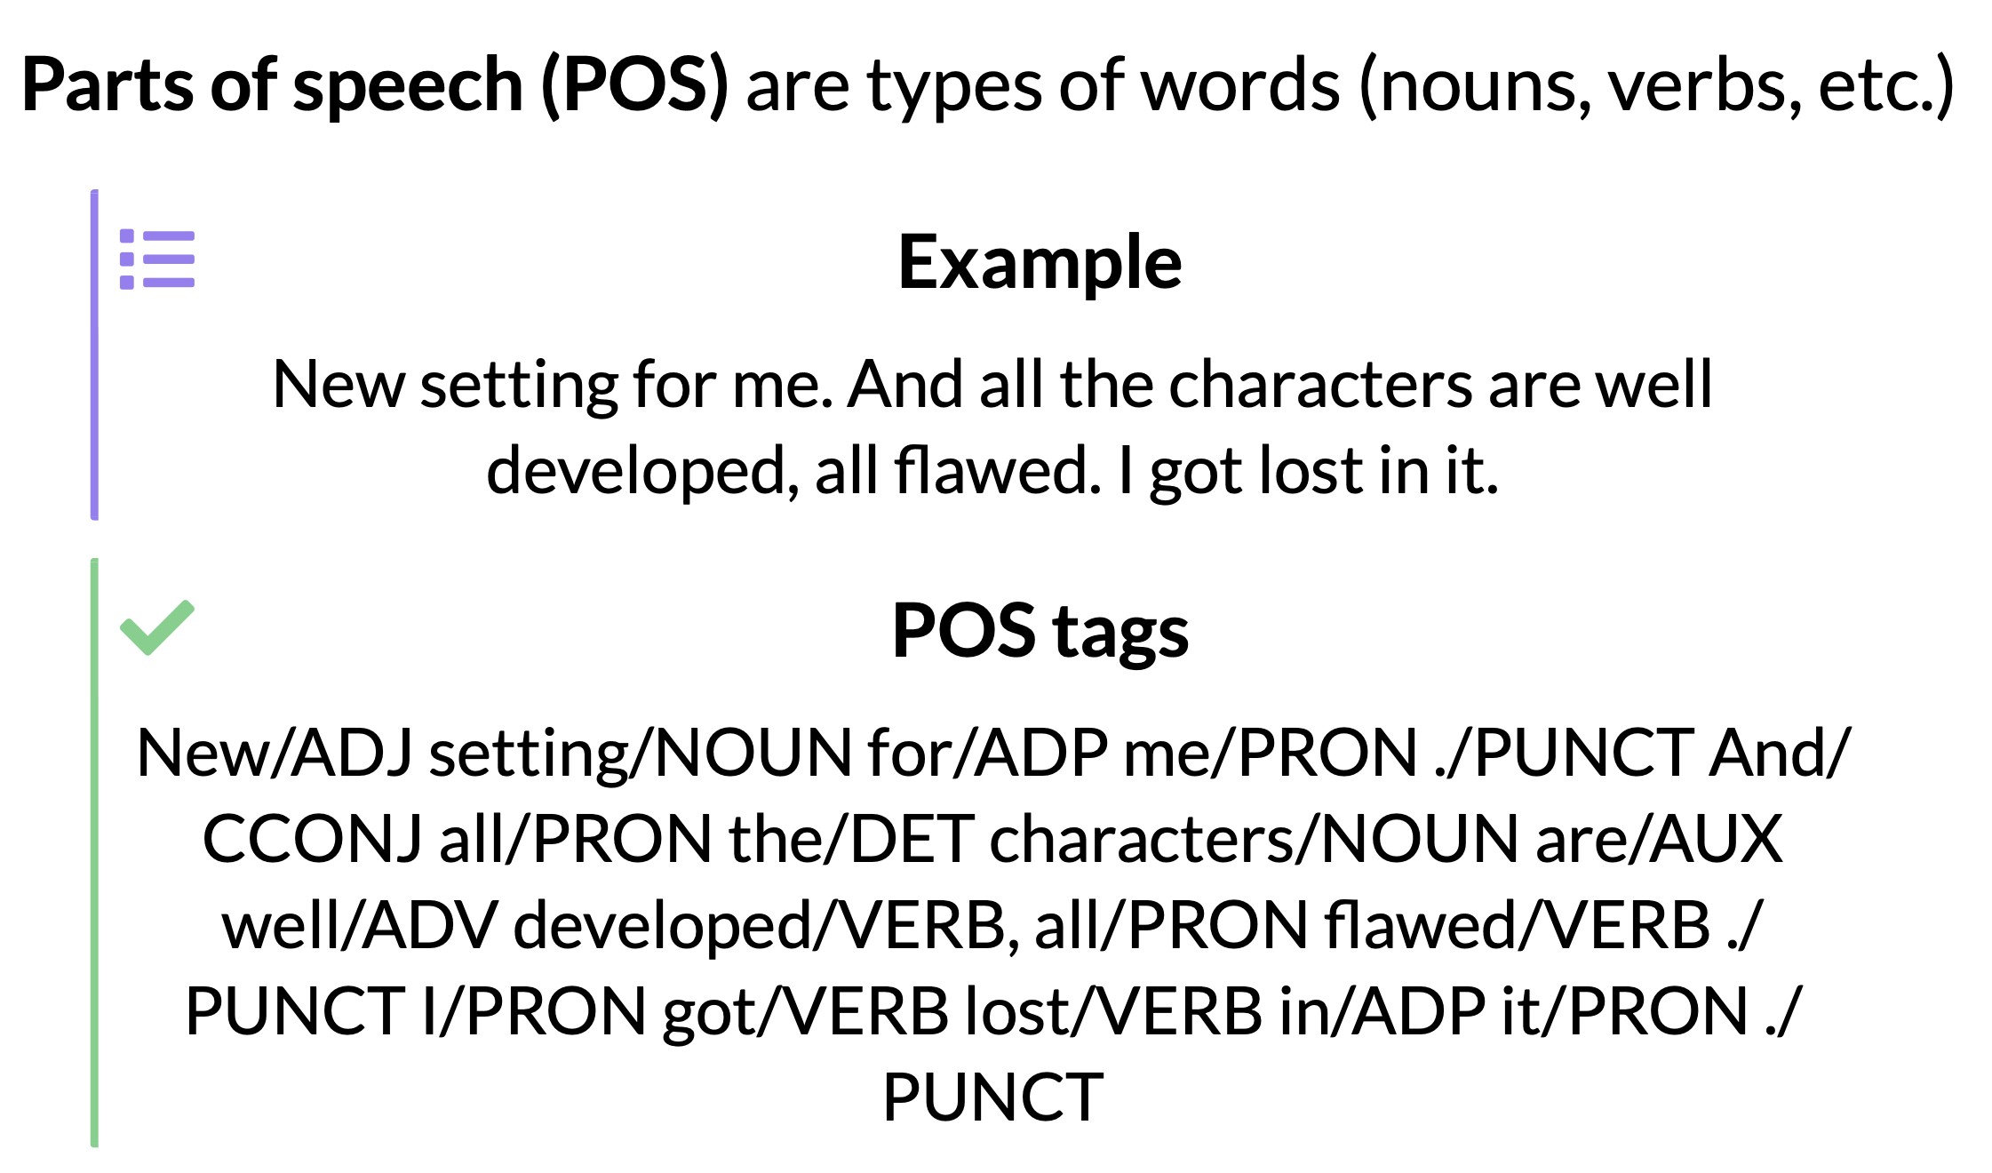
Part-of-speech (POS) tagging

Slide 66
Part-of-speech (POS) tagging
Remove ambiguity: I walk to the bus stop vs a walk in the park
Help to parse sentence structure
Search for particular structures

Slide 67
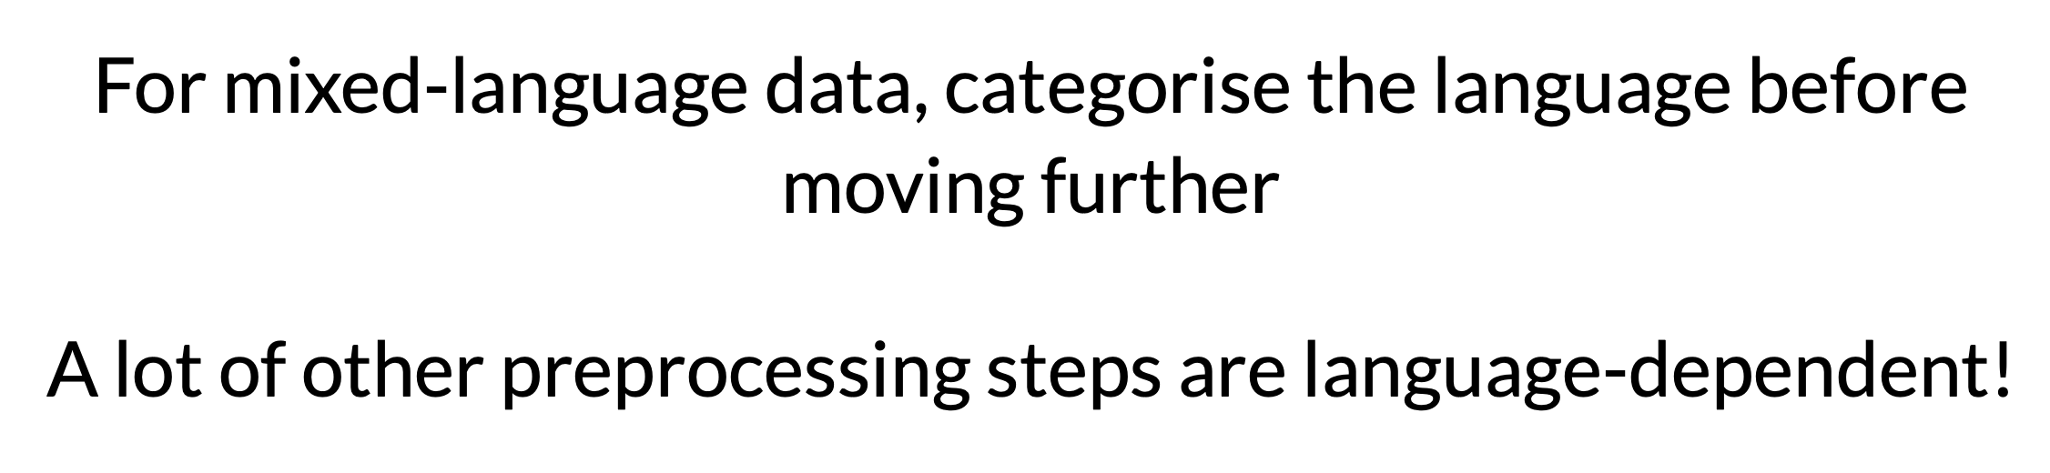
Language detection

Slide 68
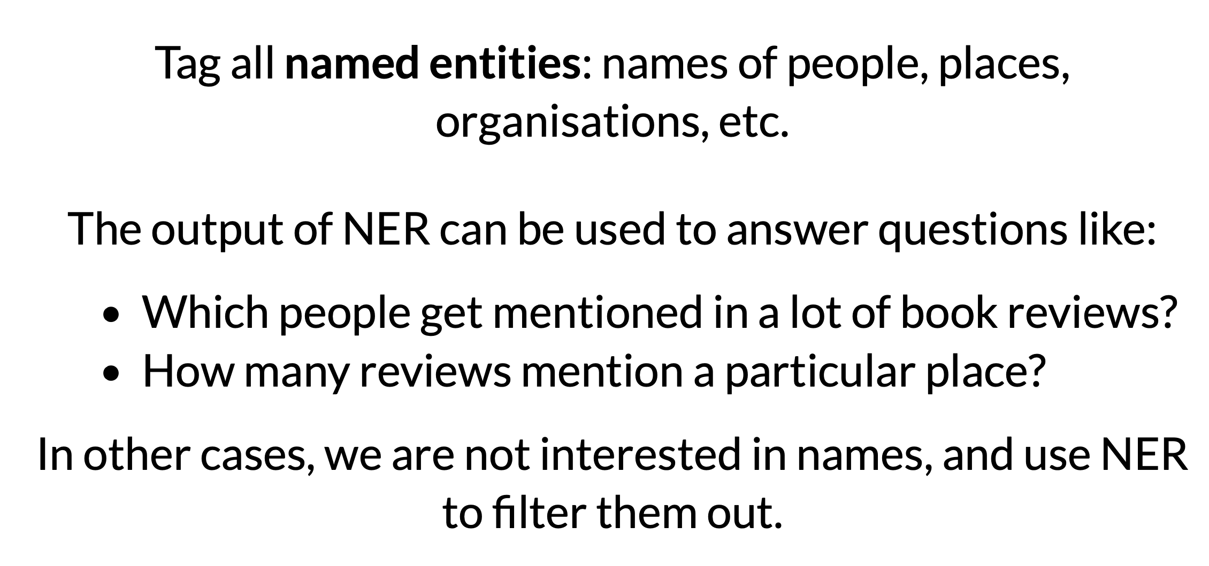
Named Entity Recognition

Slide 69
Preprocessing choices
There is no single "correct" method for preprocessing.
Each of these steps can be helpful or detrimental depending on the task.
Important factors:
Language
Type of text
Task
Amount of data
Analysis method

Slide 70
Preprocessing choices
We try to balance:
preserving information versus removing noise
maximising the informativity or likelihood of observations
As a general rule:
With small dataset and simple models, your analysis will struggle to handle noisy data.
A large model with lots of data will benefit from richer input.

Slide 71
We can stop here and work on lab/practical 1 until Q19.
Notes:
The theme of this course
71

Slide 72
Text Representation Vector Space Model
Notes:
The theme of this course
72

Slide 73
Basic idea
Text is “unstructured data”
How do we get to something structured that we can compute with?
Text must be represented somehow
Represent the text as something that makes sense to a computer

Slide 74
Vector space model
A vector space is a collection of vectors
Represent documents by concept vectors
Each concept defines one dimension
k concepts define a high-dimensional space
Element of vector corresponds to concept weight

Slide 75
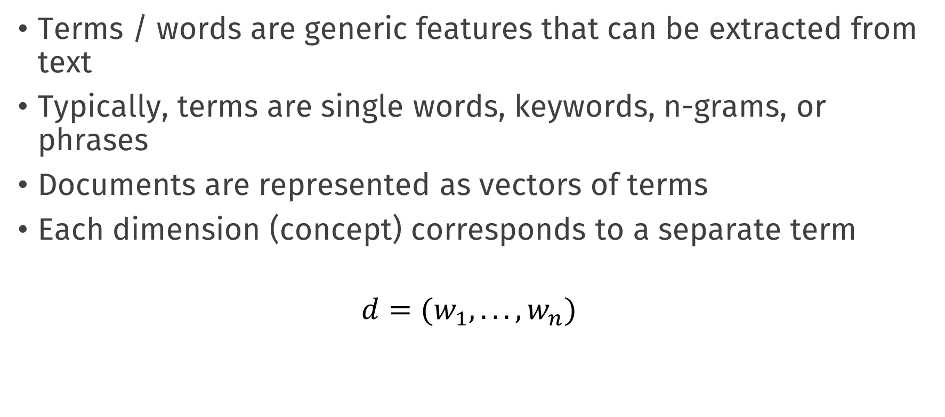
Vector space model
Terms / words are generic features that can be extracted from text
Typically, terms are single words, keywords, n-grams, or phrases
Documents are represented as vectors of terms
Each dimension (concept) corresponds to a separate term
$$d=(w_{1},...,w_{n})$$

Slide 76
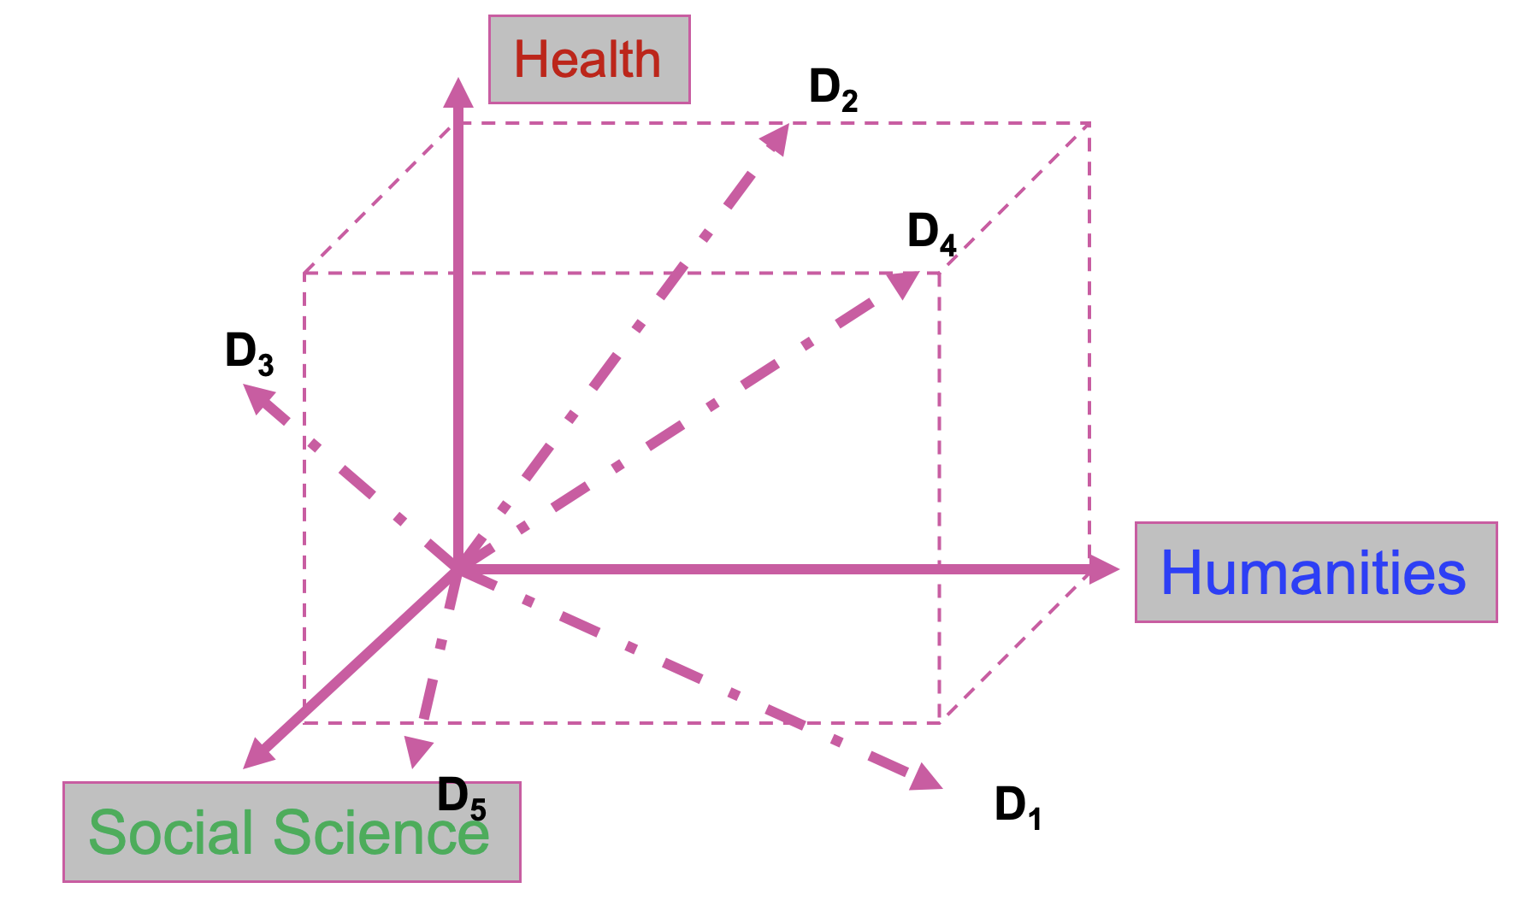
An illustration

Slide 77
Vectorization
The process of converting text into numbers is called Vectorization
Distance between the vectors in this concept space
Relationship among documents

Slide 78
VSM representations
Bag-of-Words
TF, TFiDF
High Dimensional, Sparse
Topics
Topic modeling, Clustering
Low Dimensional
Word Embeddings
W2Vec, fasttext, transformers
Dense representation,
Distributional hypothesis

Slide 79
Bag-of-Words
Terms are words (more generally we can use n-grams)
Weights are number of occurrences of the terms in the document
Binary
Term Frequency (TF)
Term Frequency inverse Document Frequency (TFiDF)

Slide 80
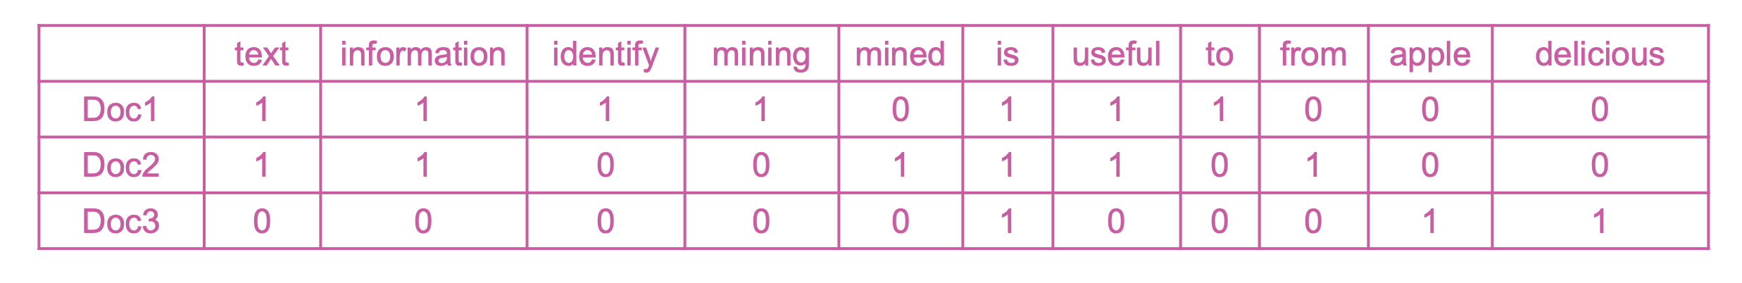
Example
Doc1: Text mining is to identify useful information.
Doc2: Useful information is mined from text.
Doc3: Apple is delicious.
Document-Term matrix (DTM):

Slide 81
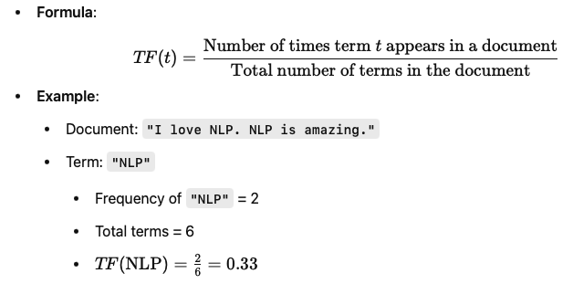
Term Frequency (TF)
A measure to evaluate how often a word (or term) appears in a document relative to the total number of words in that document.
TF helps in ranking terms based on their prominence within a document.

Slide 82
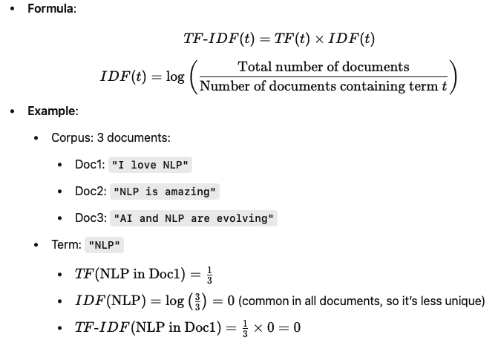
TF-IDF
TF-IDF combines TF with
Inverse Document Frequency (IDF)
to assess how important a term is
within a document relative to an
entire corpus/dataset.

Slide 83
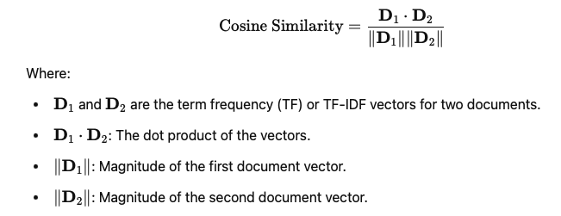
What to do with the vectors?
We can check documents’ similarity!
Cosine similarity

Slide 84
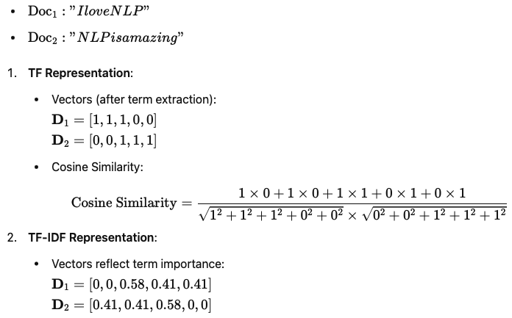
What to do with the vectors?

Slide 85
What to do with the vectors?
We can check documents’ similarity!
Document Similarity:
Used in search engines to rank documents based on their relevance to a query.
Example: Comparing a user's query with a corpus of documents to find the most relevant ones.
Plagiarism Detection:
Compares textual content to identify overlapping or similar phrases and ideas.
Clustering and Classification:
Groups similar documents or sentences in tasks like topic modeling and text categorization.
Recommendation Systems:
Finds content (e.g., articles, products) similar to a given input based on textual metadata.

Slide 86
Conclusion
Text is everywhere!
Text Mining and NLP is the topic of the day!
Regular expression is a good start.
Text Preprocessing: is the process of cleaning, normalizing, and structuring raw text data into a format suitable for analysis or input into NLP models.
Vector Space Model is the common way for text representation.
Cosine similarity is a fundamental metric in NLP, enabling the comparison of textual data.

Slide 87
Questions?

